Slide 1
Wide & Deep Learning for Recommender Systems Heng-Tze Cheng Published in: Proceedings of the 1st Workshop on Deep Learning for Recommender Systems
報告者：陳克威
日 期：2019/5/9

Slide 2
Introduction

Slide 3
Introduction
A recommender system can be viewed as a search ranking system, where the input query is a set of user and contextual information, and the output is a ranked list of items.
Given a query, the recommendation task is to find the relevant items in a database and then rank the items based on certain objectives, such as clicks or purchases.
Notes:
推薦系統可以被視為搜索排名系統，其中輸入查詢是一組用戶和上下文信息，並且輸出是項目的排序列表。
給定查詢，推薦任務是在數據庫中查找相關項目，然後基於某些目標（例如點擊或購買）對項目進行排名。

Slide 4
Introduction
One challenge in recommender systems, similar to the general search ranking problem, is to achieve both memorization and generalization.
Memorization can be loosely defined as learning the frequent co-occurrence of items or features and exploiting the correlation available in the historical data.
Generalization, on the other hand, is based on transitivity of correlation and explores new feature combinations that have never or rarely occurred in the past.
Notes:
與一般搜索排名問題類似，推薦系統中的一個挑戰是實現記憶和概括。
Memorization可以鬆散地定義為學習項目或特徵的頻繁共現並利用歷史數據中可用的相關性。
Generalization是基於相關的傳遞性，並探索過去從未或很少發生的新特徵組合。

Slide 5
Introduction
generalized linear models such as logistic regression are widely used because they are simple, scalable and interpretable.
The models are often trained on binarized sparse features with one-hot encoding. E.g., the binary feature “user_installed_app=netflix” has value 1 if the user installed Netflix.
Memorization can be achieved effectively using cross-product transformations over sparse features, such as AND(user_installed_app=netflix, impression_app=pandora”), whose value is 1 if the user installed Netflix and then is later shown Pandora.
Notes:
邏輯回歸的廣義線性模型被廣泛使用，因為它們簡單，可擴展且可解釋。
模型通常使用單熱編碼訓練二值化稀疏特徵。 例如，如果用戶安裝了Netflix，則二進制功能“user_installed_app = netflix”的值為1。
使用稀疏功能上的跨產品轉換可以有效地實現記憶，例如AND（user_installed_app = netflix，impression_app = pandora“），如果用戶安裝了Netflix，則其值為1，然後顯示為Pandora。

Slide 6
Introduction
This explains how the co-occurrence of a feature pair correlates with the target label.
Generalization can be added by using features that are less granular, such as AND(user_installed_category=video, impression_category=music), but manual feature engineering is often required.
One limitation of cross-product transformations is that they do not generalize to query-item feature pairs that have not appeared in the training data.
Notes:
這解釋了特徵對的共現如何與目標標籤相關聯。
可以使用不太精細的功能（例如AND（user_installed_category = video，impression_category = music））添加泛化，
但通常需要手動功能工程。
跨產品轉換的一個限制是它們不會推廣到未出現在訓練數據中的查詢項功能對。

Slide 7
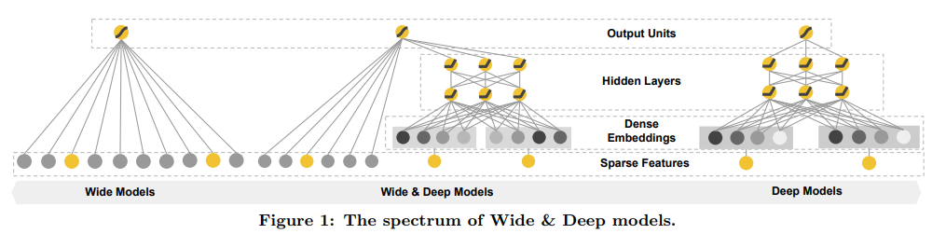
Introduction
Embedding-based models, such as factorization machines or deep neural networks, can generalize to previously unseen query-item feature pairs by learning a low-dimensional dense embedding vector for each query and item feature, with less burden of feature engineering.
Notes:
可以通過為每個查詢和項目特徵學習低維密集嵌入向量來概括到先前未見過的查詢項目特徵對，同時減少特徵工程的負擔。

Slide 8
RECOMMENDER SYSTEM OVERVIEW

Slide 9
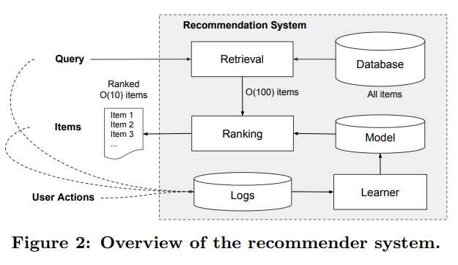
RECOMMENDER SYSTEM OVERVIEW
Ranking :
The scores are usually P(y|x)
P(user action | features x)
Notes:
因為要在10ms內處理，所以不可能全部app都評分，所以第一步要先檢索，
檢索系統，通常是[機器學習模型]和[人類定義規則]的組合。
user_profile(性別, 年齡, 語言)，context(國家, 當下時間, 設備)，

Slide 10
WIDE & DEEP LEARNING

Slide 11
WIDE
The wide component is a generalized linear model of the form y = wT x + b, as illustrated in Figure 1 (left).
y is the prediction,
x = [x1, x2, ..., xd] is a vector of d features,
w = [w1, w2, ..., wd] are the model parameters and b is the bias.

Slide 12

WIDE
The feature set includes raw input features and transformed features.
One of the most important transformations is the cross-product transformation.
where cki is a boolean variable that is 1 if the i-th feature is part of the k-th transformation φk, and 0 otherwise.
For binary features, a cross-product transformation (e.g., “AND(gender=female, language=en)”) is 1 if and only if the constituent features (“gender=female” and “language=en”) are all 1, and 0 otherwise.
Notes:
其中cki是布爾變量，如果第i個特徵是第k個變換φk的一部分則為1，否則為0。
對於二元特徵，當且僅當組成特徵（“gender = female”和“language = en”）都是1時，跨產品轉換（例如，“AND（gender = female，language = en）”）為1 ，否則為0。

Slide 13

DEEP
sparse, high-dimensional categorical features (“language=en”)
embedding vector (O(10) to O(100).)
Notes:
Activetion Function = ReLu

Slide 14
Joint Training of Wide & Deep Model
The wide component and deep component are combined using a weighted sum of their output log odds as the prediction, which is then fed to one common logistic loss function for joint training.
Note that there is a distinction between joint training and ensemble.

Slide 15

Joint Training of Wide & Deep Model
optimizer (wide): Followthe-regularized-leader (FTRL)
optimizer (deep): AdaGrad
logistic loss function
Notes:
sigmoid

Slide 16
SYSTEM IMPLEMENTATION

Slide 17
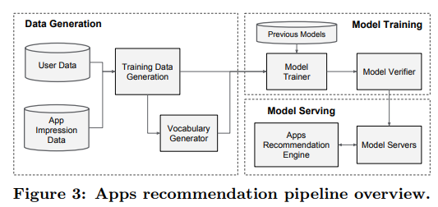
SYSTEM IMPLEMENTATION
Notes:
Data Generate的部分主要是做資料前處理，像是one hot encoding , 字串轉換以及離散化。
Vocabularies, which are tables mapping categorical feature strings to integer IDs,
Model train的部分就是他會做online learning，只要有新的資料進來，他就會將過去的權重拿出來，繼續學習微調權重。
Model serving的部分是希望能在10ms去做response，因此他們使用multithreading 以及batch設定進行加速。
Wide＆Deep模型接受了超過5000億個示例的培訓。 每當一組新的訓練數據到達時，該模型需要重新訓練。
然而，每次從頭開始重新訓練都是計算上昂貴的，並且延遲了從數據到達到服務更新模型的時間。
為了應對這一挑戰，我們實施了一個熱啟動系統，該系統使用先前模型中的嵌入和線性模型權重初始化新模型。

Slide 18
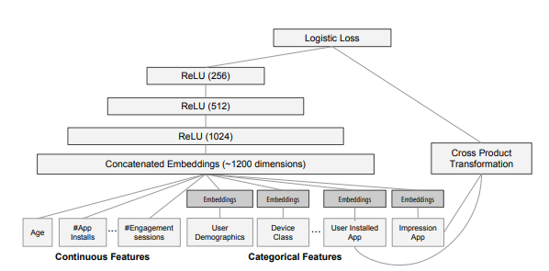
SYSTEM IMPLEMENTATION
Notes:
Model Training

Slide 19
EXPERIMENT RESULTS

Slide 20
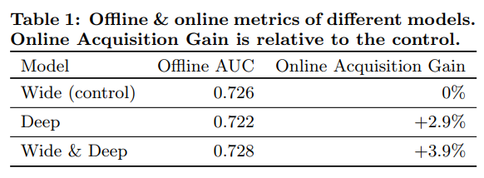
EXPERIMENT RESULTS
Notes:
A/B Test for 3weeks

Slide 21
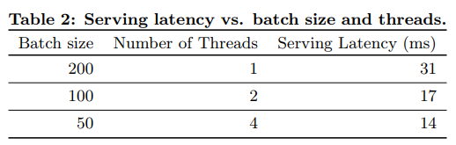
EXPERIMENT RESULTS
Notes:
A/B Test for 3weeks

Slide 22
Thanks for listening.
報告者：陳克威
日 期：2019/5/9

